Slide 1
Tetris JUnit and Test Coverage Criteria
Presented by: EJ, Neo and Rob

Slide 2
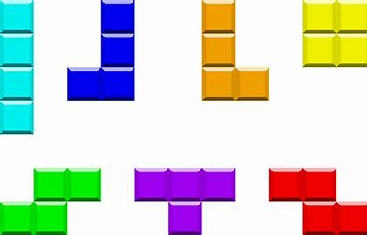
Overview
How we approached the project
Progress Update #1-4
Final Results
Bugs Encountered
Challenges faced
Thoughts/Final Remarks
Conclusion/Questions

Slide 3
Process Application
Divide and conquer the java files for each team member to sketch cfgs.
Tasked ourselves to create JUnit tests to recreate onto the test files.
Documenting our report and presentation slides to record our tests.
01
03
05
02
04
Created PPC for each function given within the application.
Reverse engineer our steps to trace our branches within the test files.

Slide 4
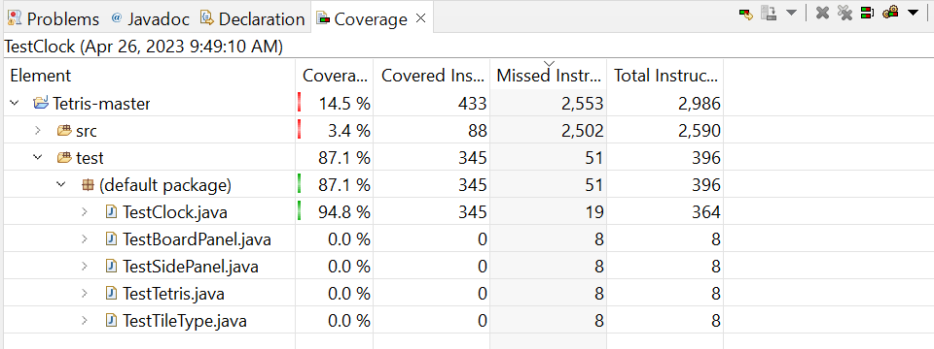
Progress Update #1
Clock Modification:
Benefits:
Shortest class to do JUnit tests.
Fastest to complete.
A good sample size to practice JUnit.
Drawbacks:
Does not cover much of the src folder.
Overall coverage is 14.5%.
Clock is a dependent class with other classes.

Slide 5
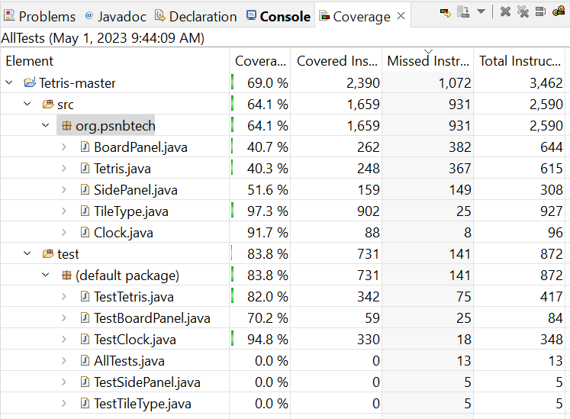
Progress Update #2
Tetris Modification:
Benefits:
The parent class
Covers every path within the package
Covered instructions with an increase of 54.5% from total coverage (Tetris-master)
Drawbacks:
Tedious work
Requires multiple test functions
Changed clock coverage with new changes

Slide 6
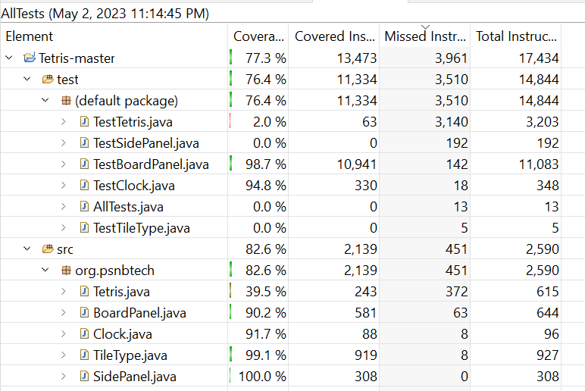
Progress Update #3
BoardPanel Modification:
Benefits:
Slightly boosted the total coverage.
src folder would include a variety of files that have been covered.
Consistent than before.
Drawbacks:
Neglected other test cases that have been covered previously on TestTetris.
TestTetris took a nosedive from 82% to 2%.
Requires multiple test functions to improve the board.

Slide 7
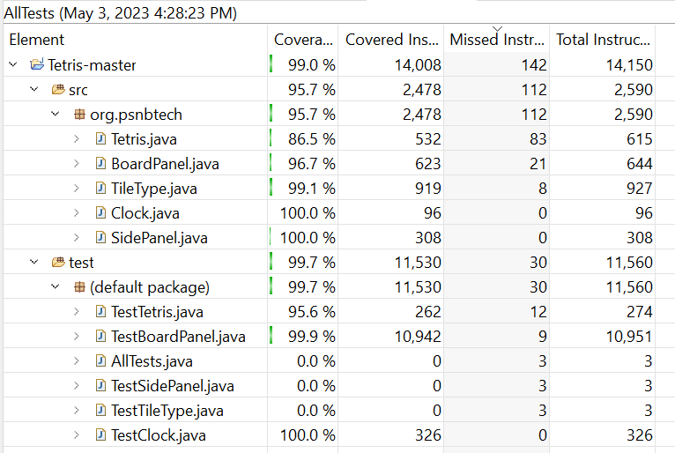
Progress Update #4
BoardPanel + Tetris modification:
Benefits:
Highlights all the branch coverages on all files in src and test.
Indicates that other files are covered without inspection.
Drawbacks:
Patiently waiting to finish the game to get the full JaCoCo score.
Not controlling the game
Not closing the game early

Slide 8
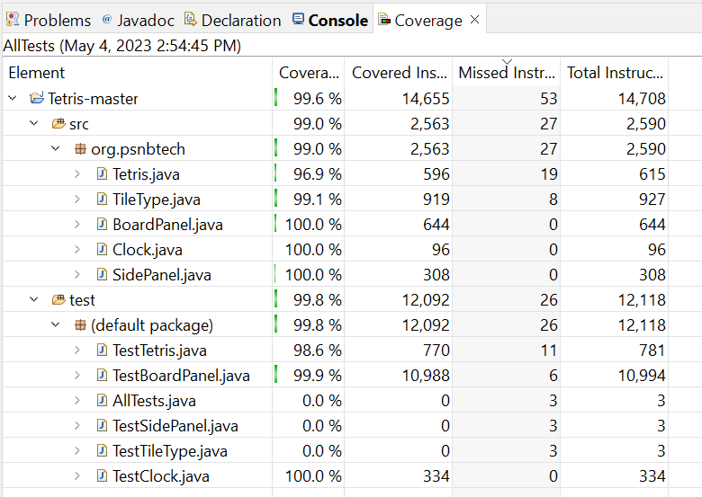
Final Results
Varies between 99.4-99.6
The big classes Tetris and BoardPanel would indicate the branch coverages.
Not solving the other instructions for AllTests.java, TestSidePanel.java and TestTileType.java.
Can be inconsistent to satisfy the cases within testTetris.java due to the longevity of the game.

Slide 9
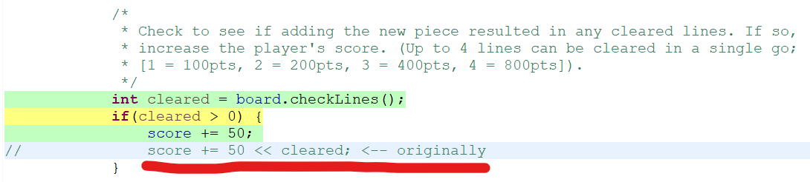
Bugs Encountered
Tetris.java

Slide 10
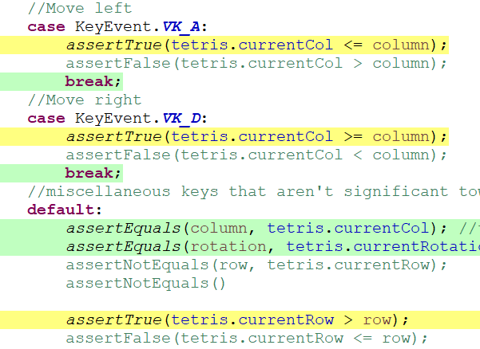
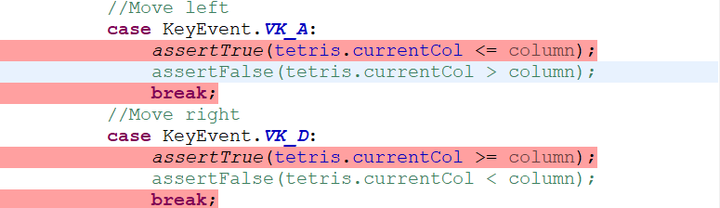
Challenges Faced:
Modifying current test cases
Debugging constantly
Total instructions change over time
Some test methods have inconsistency to translate onto JaCoCo
Knowing when and how to control the tetris game on the board
PATIENCE

Slide 11
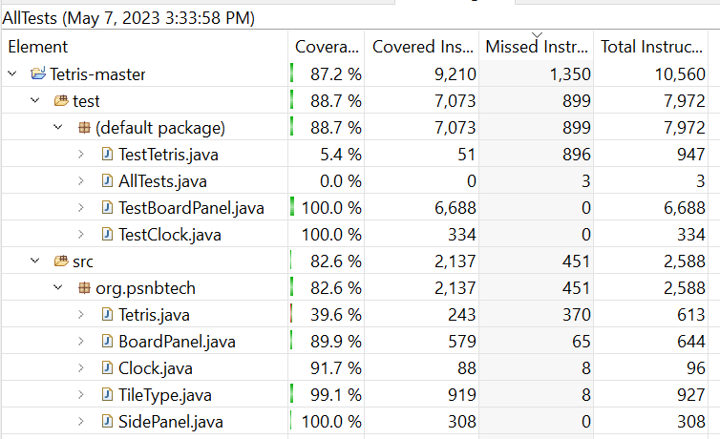
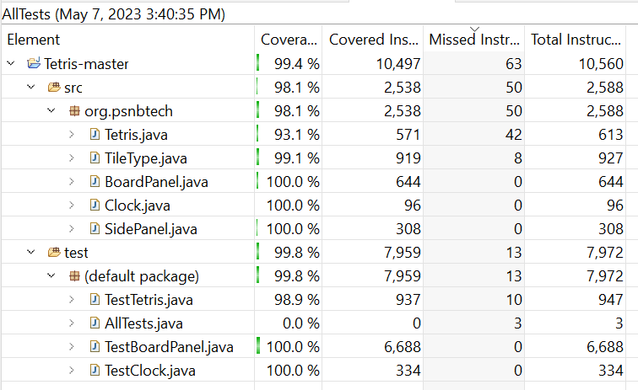
Future Improvements
Improve on getting a higher JaCoCo score
Add test cases for tetris main
Add potential features to cover more test cases
Additional:
Keeping a consistent rotatePiece test method
Add

Slide 12
Questions‽

Slide 13

Video Demo

